Slide 1
Chronische obstipatie: voorbij het laxeren
Daniel Keszthelyi
Maastricht University Medical Center
The Netherlands
Cursorisch onderwijs, Veldhoven 2019

Slide 2
Disclosure of Conflicts of Interest
I herewith declare the following paid or unpaid consultancies, business interests or sources of honoraria payments in the period since October 1, 2015, and anything else which could potentially be viewed as a conflict of interest:
Name of the enterprise // Nature of the interest
Will Pharma BV: Research funding
Grünenthal GmbH: Research funding
Allergan plc: Research funding
Bayer GmbH: Advisory Board
Biocodex Benelux: Advisory Board

Slide 3
De typische verwijzing
30-jarige patiente met chronische obstipatieklachten. Laxantia en dieetmaatregelen helpen onvoldoende.
Graag uw visie.

Slide 4
Notes:
Het eerste wat in je opkomt: niet alweer een obstipant!

Slide 5
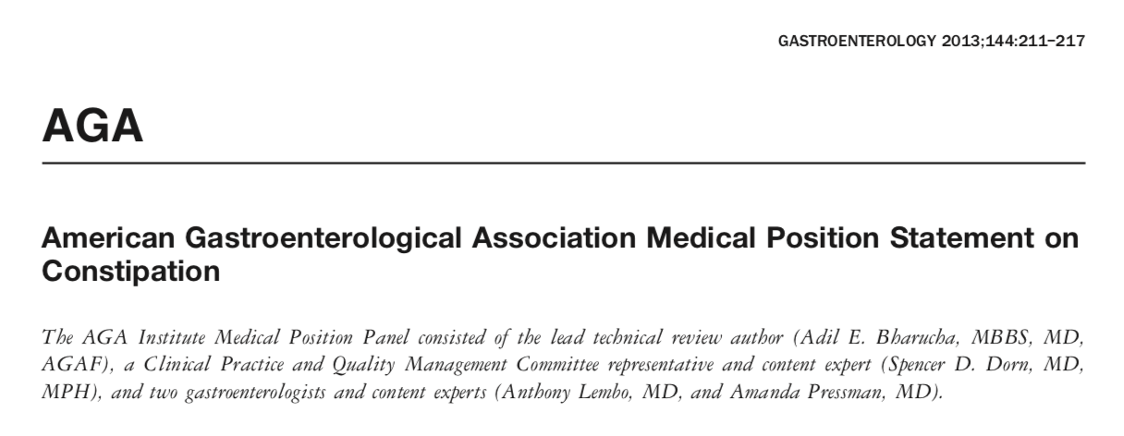
Notes:
Nou dan ga je even kijken: hoe pak ik dit aan? Ja gaat zoeken naar een richtlijn. Nederlandse richtlijn is er niet. Gelukkig is er een AGA richtlijn uit 2013

Slide 6
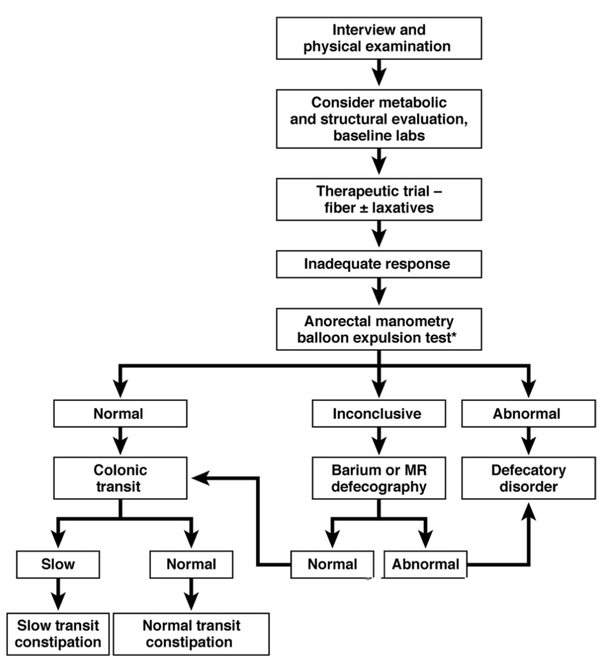

Slide 7
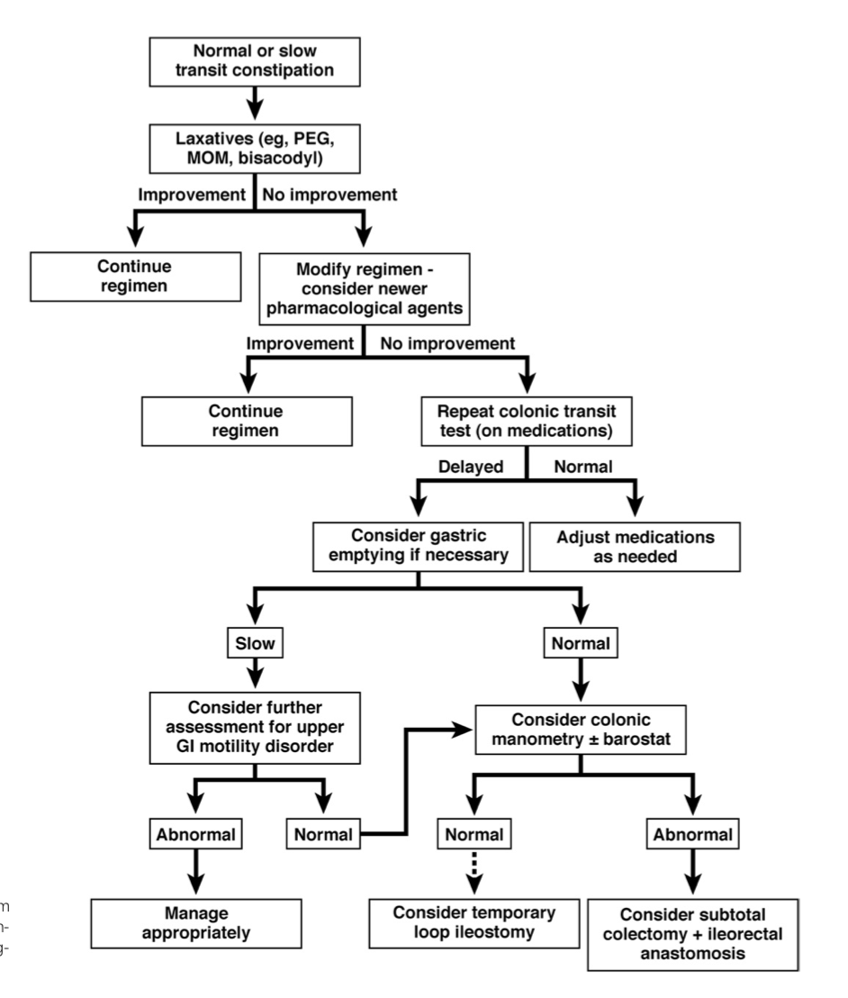

Slide 8
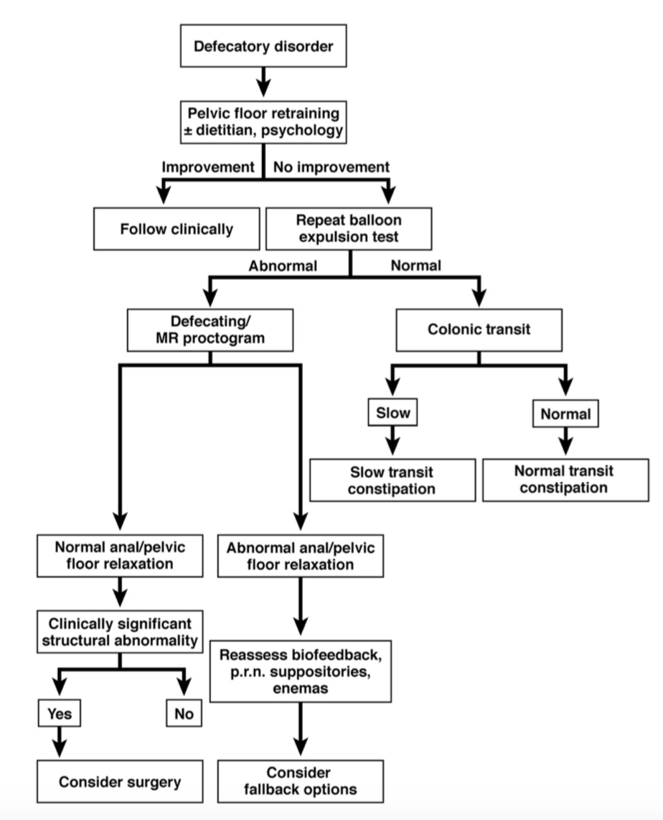

Slide 9
Dietary/lifestyle advice
Laxatives (PEG/bisacodyl)
referral

Slide 10
Dietary/lifestyle advice
Laxatives (PEG/bisacodyl)
referral
Check for red flag conditions/
exclude organic disease/
Constipation due to medication

Slide 11
Dietary/lifestyle advice
Laxatives (PEG/bisacodyl)
referral
Perform diagnostic test to ascertain pathomechanism
Slow colon transit
Rectal evacuatory dysfunction

Slide 12
Colon transit time (radiopaque marker study)

Slide 13
Colon transit time (radiopaque marker study)
Number of retained markers does not correlate with symptom severity of constipation or QoL (Staller et al. NGM 2018)
Rectosigmoid localization of radiopaque markers does not correlate with prolonged balloon expulsion in chronic constipation (Staller et al. Am J Gastroenterol 2015)
Notes:
Hinton en Metcalfe

Slide 14
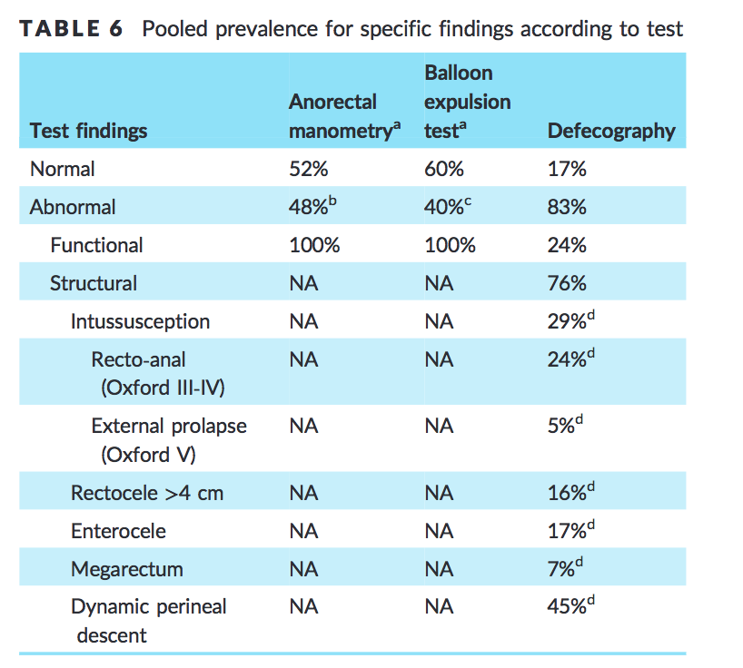
Rectal evacuatory dysfunction
Grossi et al. Systematic review with meta‐analysis: defecography should be a first‐line diagnostic modality in patients with refractory constipation APT 2018

Slide 15
Alternative methods to assess rectal evacuatory dysfunction
Park et al. Rectal Gas Volume Measured by Computerized Tomography Identifies Evacuation Disorders in Patients With Constipation. Clinical Gastroenterology and Hepatology 2017;15:543–552 n=141

Slide 16
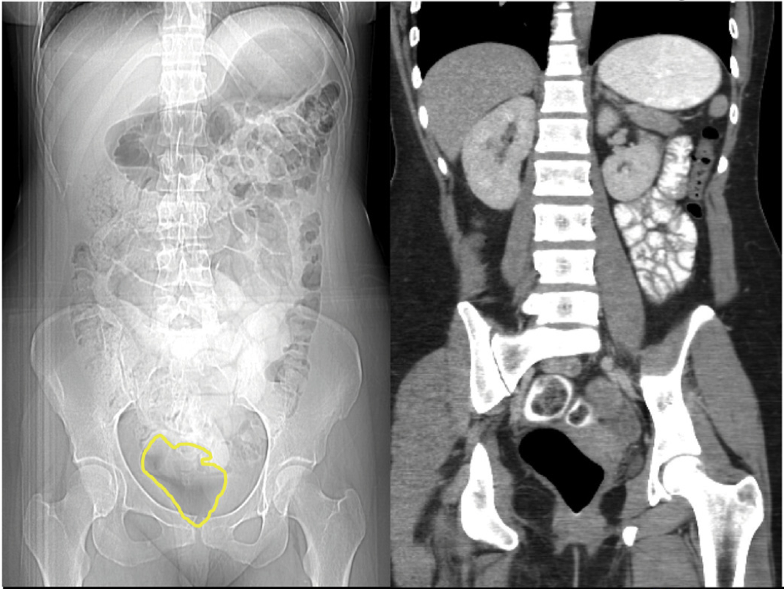

Slide 17
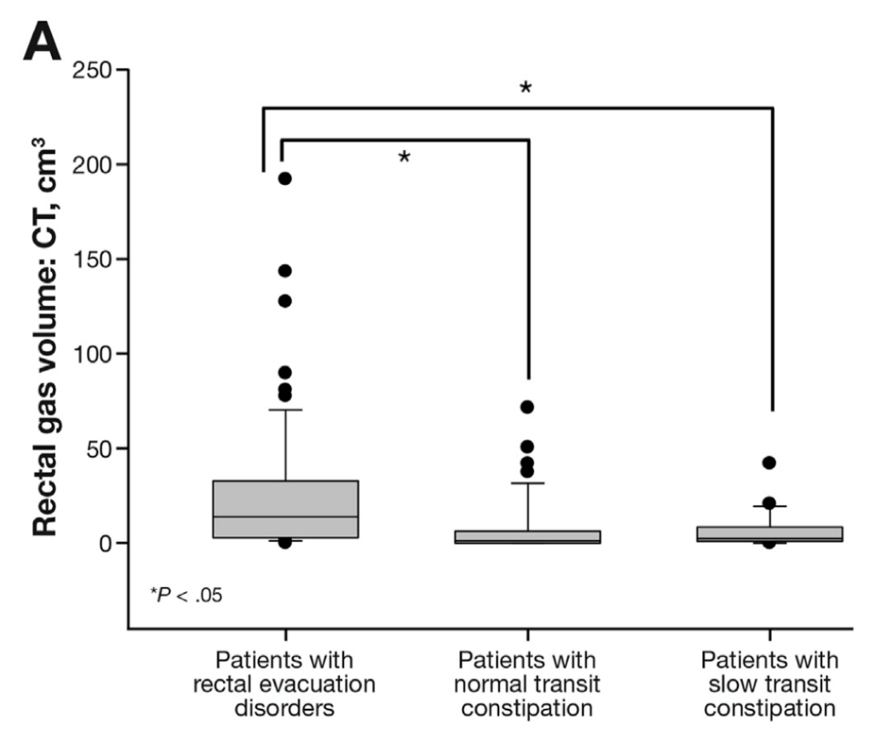
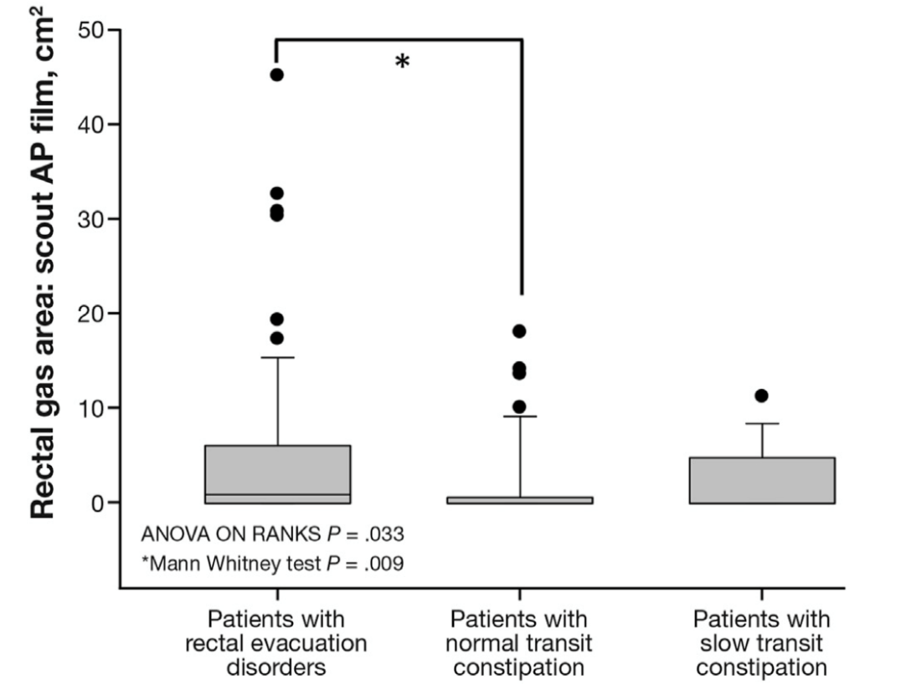

Slide 18
Dietary/lifestyle advice
Laxatives (PEG/bisacodyl)
referral
Perform diagnostic test to ascertain pathomechanism
Slow colon transit
Novel drugs (linaclotide/prucalopride)

Slide 19
Novel agents
 | FDA approved | EMA approved | Reimbursement in NL
Prucalopride (5HT₄ agonist)
Lubiprostone (chloride channel activator)
Linaclotide (GC agonist)
Plecanatide (GC agonist)
Tenapanor (NHE3 inhibitor)
Notes:
Nelson Gut 2017 meta-analysis
Lubiprostone is available in such European countries
You can see that only linaclotide is approved for reimbursement for the NL so let’s discuss this drug in more detail

Slide 20
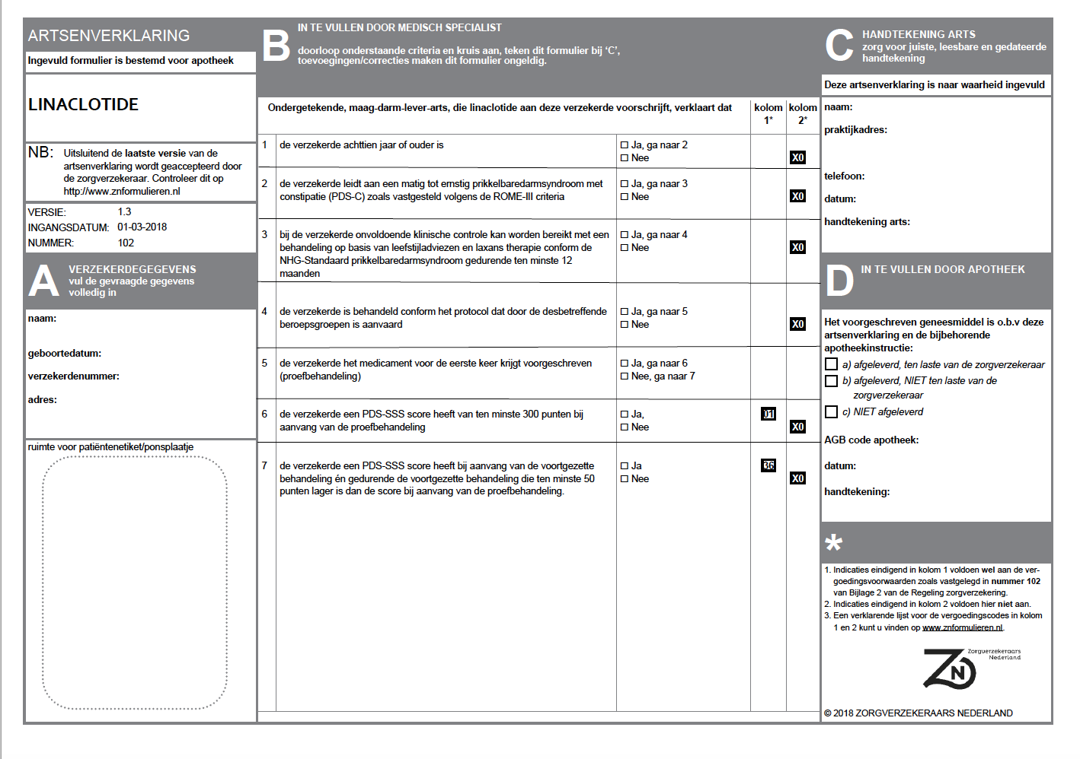
Notes:
So why all the fuss - the drug is fairly expensive and the authorities raised concerns that there were no Dutch data on efficacy
Prucalopride – its worth a try sending a letter to the medical advisor of the patients’ health insurance company and chances are they will reimburse the drug, in particular when their insurer is Zilveren Kruis achmea - i hope you recall from my disclorure slide that i dont have any financial relationship with them

Slide 21
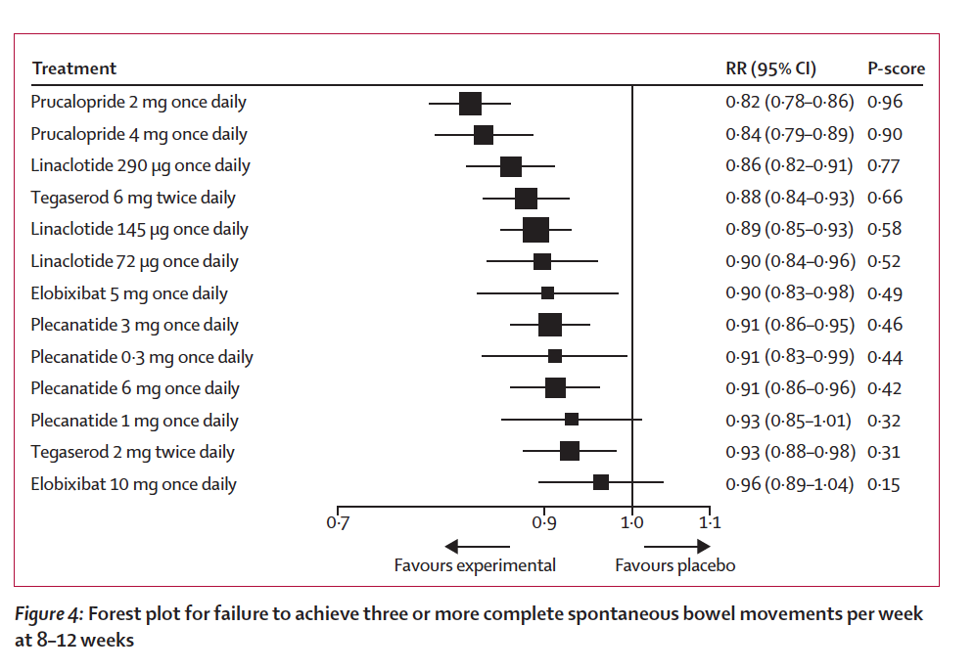
Efficacy of drugs in chronic idiopathic constipation:
a systematic review and network meta-analysis
Lancet Gastroenterology August 2019

Slide 22
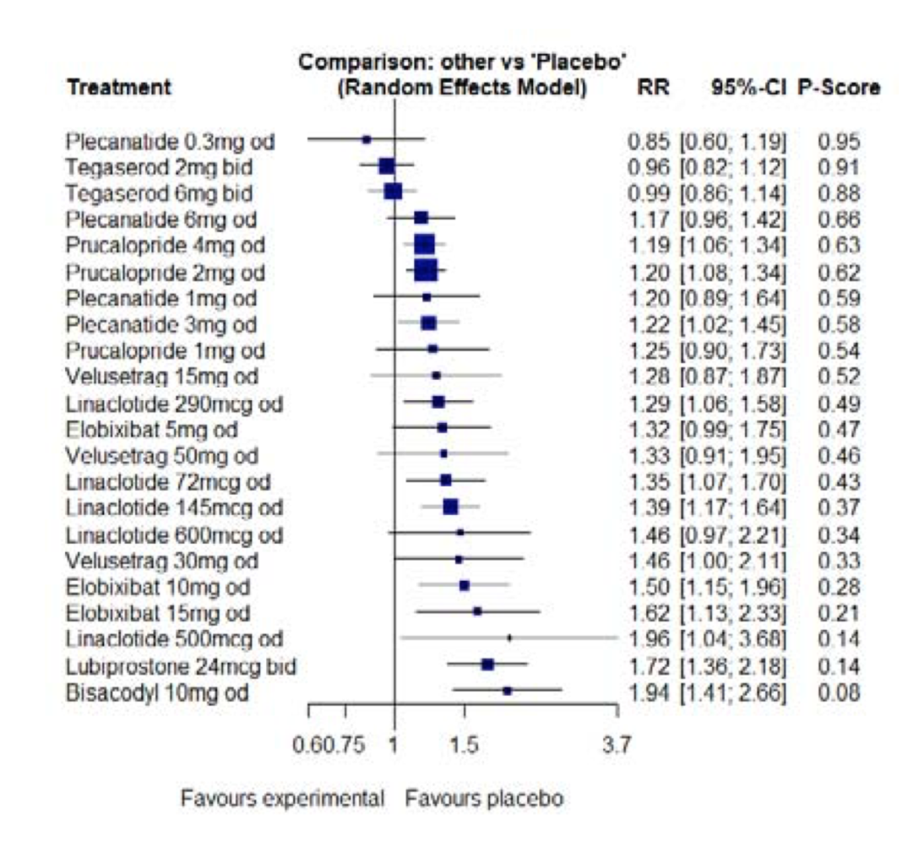
Side effects

Slide 23
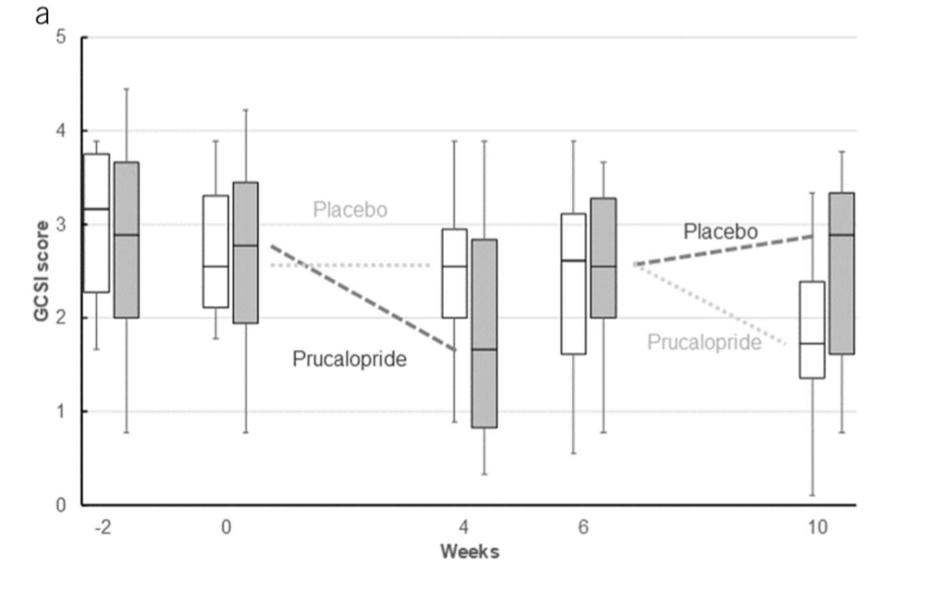
Prucalopride and gastroparesis
Carbone et al. Am J Gastroenterol 2019
N=34

Slide 24
Dietary/lifestyle advice
Laxatives (PEG/bisacodyl)
referral
Perform diagnostic test to ascertain pathomechanism
Slow colon transit
Rectal evacuatory dysfunction
Novel drugs (linaclotide/prucalopride)
Pelvic floor physicotherapy/
biofeedback
Transanal irrigation
Sacral neuromodulation
Antegrade irrigation (PEC/Malone/Chait)

Slide 25
Transanal irrigation
Navina Classic
Peristeen
Navina Smart

Slide 26
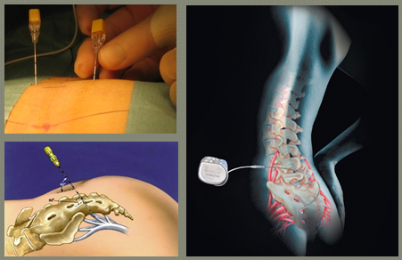
Non-invasive and minimally invasive therapies
Transanal irrigation: ca. 50% response (Bennett et al. BMC Gastro 2015)
Antegrade irrigation: Malone/PEC/Chait (50% response, Stijbos et al. NGM 2017, Sturkenboom et al. Int J Colorectal Dis 2018)
Percutaneous tibial nerve stimulation: no effect (Kumar et al. Colorectal Dis 2017)
Sacral neuromodulation – trial in the Netherlands currently ongoing (S. Breukink Maastricht, C. Baeten Gouda)

Slide 27
Take home message
Simple diagnostic approach to ascertain pathophysiological background
Use diagnostic tools for purposes of patient education
Educate patients on different treatment options
Avoid invasive/irreversible surgical interventions and always make decision for surgery in MDT

Slide 28
Questions?
d.keszthelyi@mumc.nl

Slide 29
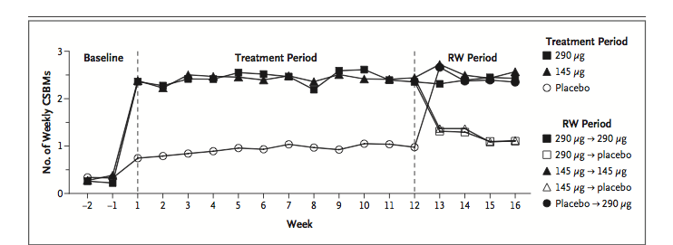
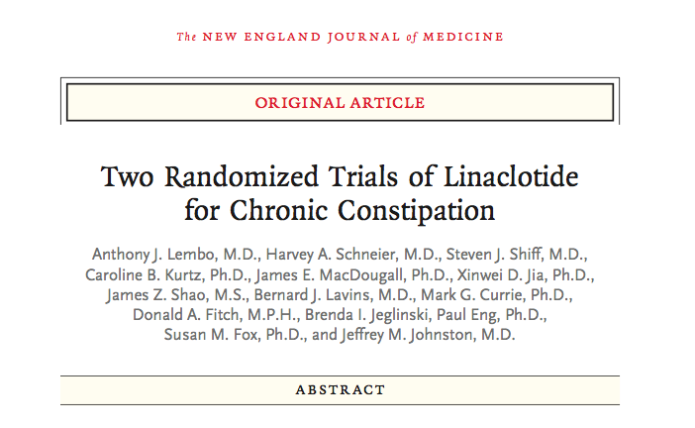
Notes:
2011
So let’s review the evidence of the efficacy
Landmark paper

Slide 30
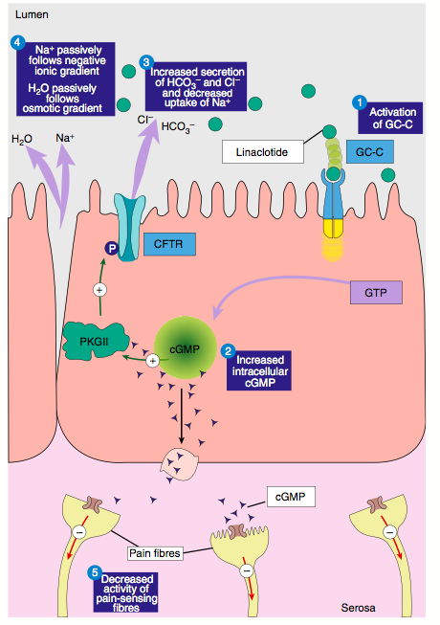
Layer and Stanghellini AP&T 2014

Slide 31
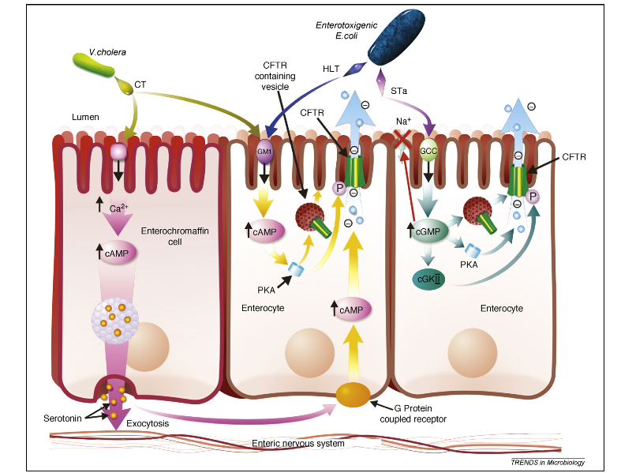
Guttmand and Finley 2009
Notes:
So let’s now take a look at this highly effective mechanism from another perspective
This diagram shows that the heat stable enterotoxin derived from certain strains of E. Coli exert the same effects as linaclotide

Slide 32
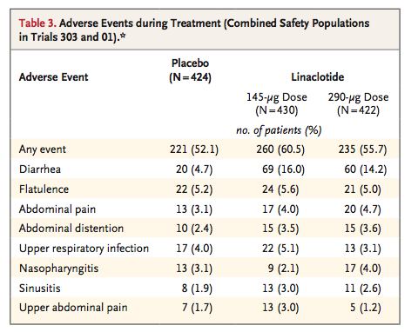

Slide 33
Real life data linaclotide in IBS-C (NGM 2018)
108 patients
45% clinical response rate in IBS-C patients
40% reported having adverse events (26% diarrhea)
43% discontinued treatment after 4 weeks

Slide 34
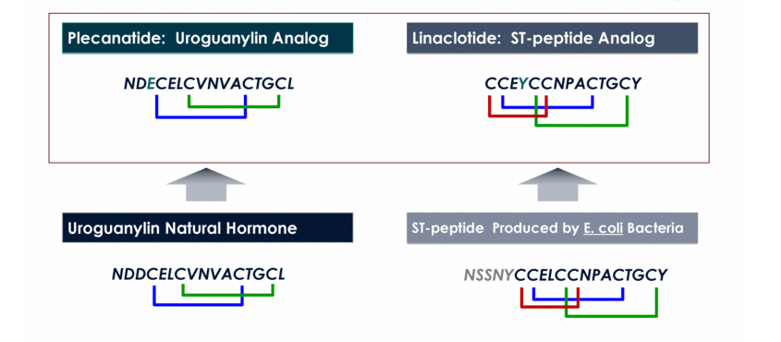
Notes:
So apparently diarrhea is a fairly important issue with linactotide and therefore, a novel agent called plecanatide has been introduced more recently and because drug chemically resembles the a natural hormone rather than a bacterial toxin, this stuctural difference is belived to to result in less potency and less severe diarrhea, mainly due to the fact that this molecule is more sensitive to luminal degradation
Chemical structure is different
-- review camilleri
Linaclotide geen protonatie, 3 disulfde verbindingen
Ts lack pH-sensitive amino acids in the N terminus,
This structural rigidity, and its pH independence, result in maximum biological activity and directly correlate with the ability of ST to cause unchecked fluid secre- tion leading to diarrhoea
It has been suggested that lower rates of diarrhoea achieved with plecanatide may reflect the pH-sen- sitive structure of that peptide, with activity limited to the acid compartment of the small intestine like uroguanylin; this may contrast with the effects of linaclotide, which are45 pH-indepen- dent and may result in activity across the rostral–caudal axis of the intestine, like STs

Slide 35
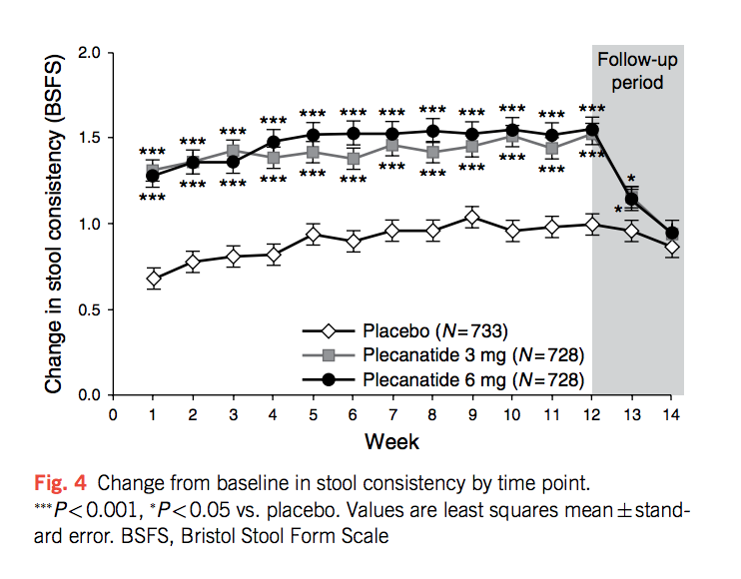
Plecanatide in IBS-C (phase 3)
Brenner et al. AJG 2018

Slide 36
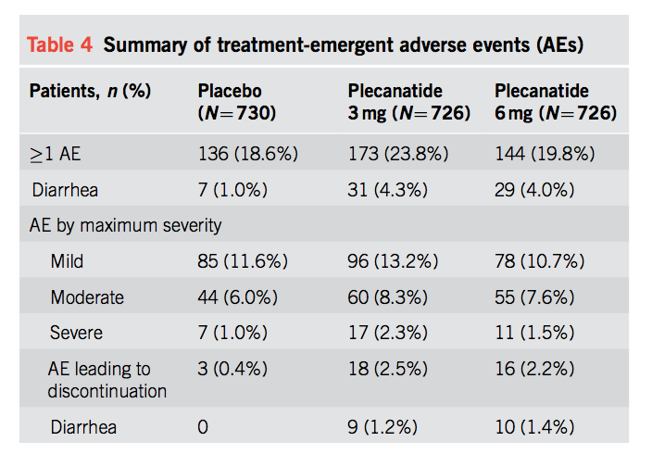
Notes:
It has been suggested that lower rates of diarrhoea achieved with plecanatide may reflect the pH-sensitive structure of that peptide, with activity limited to the acid compartment of the small intestine like uroguanylin; this may contrast with the effects of linaclotide, which are45 pH-independent and may result in activity across the rostral–caudal axis of the intestine,

Slide 37
Linaclotide vs. plecanatide
Shah et al. Am J Gastroenterol 2018
Meta-regression analysis
No differences in efficacy were observed between linaclotide and plecanatide.
Odds ratios for diarrhea as an adverse event also overlap in linaclotide and plecanatide RCTs for both CIC and IBS-C.
Differences are due to definitions of diarrhea used in these trials.
Notes:
Shah et al AJG 2018

Slide 38
Black et al. Gastroenterol 2018
15 trials with secretagogues 8462 patients
Notes:
Linaclotide (290 mcg, once daily) was ranked first in efficacy, based on the Food and Drug Administration-recommended endpoint for trials in IBS-C, the primary endpoint used in each trial, abdominal pain, and complete spontaneous bowel movements.

Slide 39
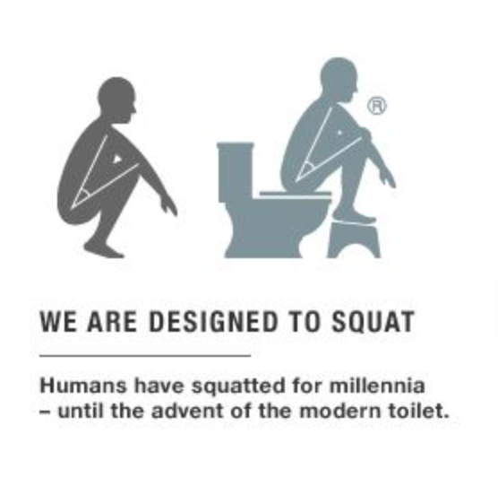
First treatment steps
1. Dietary and lifestyle modification:
Moderate physical activity and increasing fibre intake is associated with reduction in the occurance of constipation (Dukas et al. Am J Gastroenterol 2003)
- Fibre intake: ideally 30 g/day, potentially increases bloating
2. Toileting techniques
Notes:
The constipated patient will often first be seen by an GP and it is important to start with these first treatment steps that involve
History of straining and incomplete evacuation
Some fairly simple measures can help to achieve a more complete bowel evacuation

Slide 40
Second line therapy: Laxatives
Bulking agents | Osmotic laxatives | Mucosal stimulants
Psyllium | PEG Lactulose/lactitol/sorbitol Magnesium | Bisacodyl Senna
Safe and well tolerated Increases intestinal water content | Non-absorbable carbohydrates can cause bloating | Abdominal cramps
Notes:
So when these initial steps fail, we can turn to the classical laxatives
I generally avoid using lactulose and other sugar alcohols as these are subject to bacterial fermentation and can cause substantial bloating
The use of bisacodyl is generally not recommended for chronic use

Slide 41
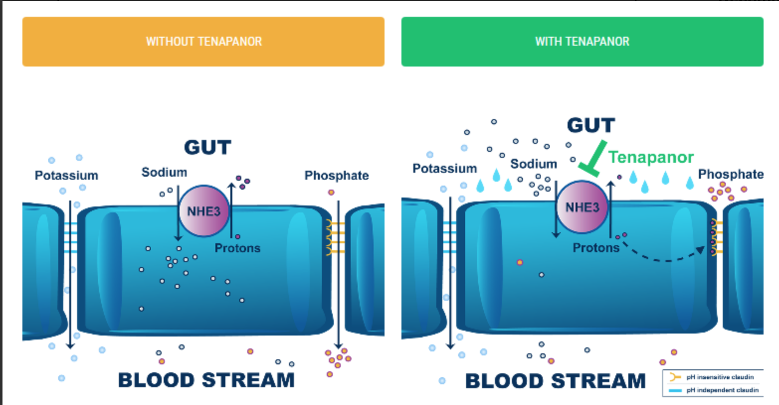
Tenapanor: NH3 channel blocker

Slide 42
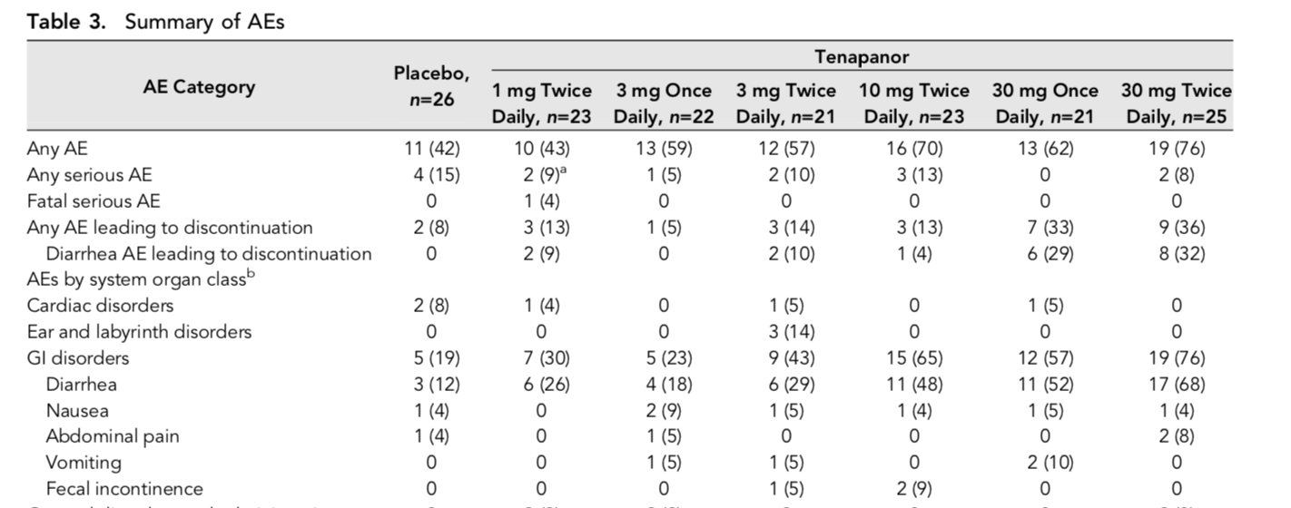
Tenapanor to decrease serum phosphate in hemodialysis
Block et al. J Am Soc Nephrol. 2017

Slide 43
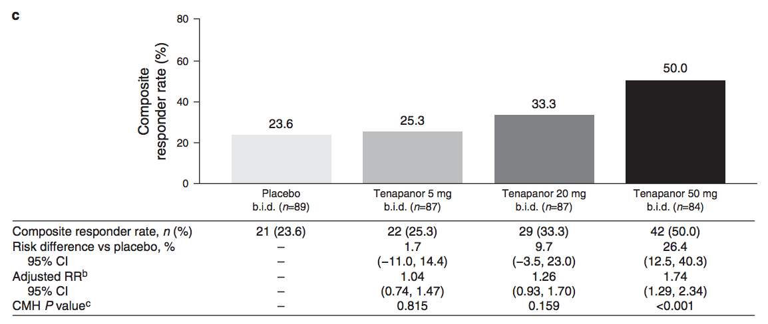
Tenapanor: phase 2 trial in IBS-C
Chey et al. AJG 2017
Notes:
Tenapanor acts in the gastrointestinal tract to reduce the absorption of sodium and phosphate, with minimal systemic drug exposure ( 15 ). Increased sodium retention in the gut in healthy volunteers treated with tenapanor enhances intestinal fl uid volume and transit, as demonstrated by soft er stools and an increase in the frequency of bowel movements

Slide 44
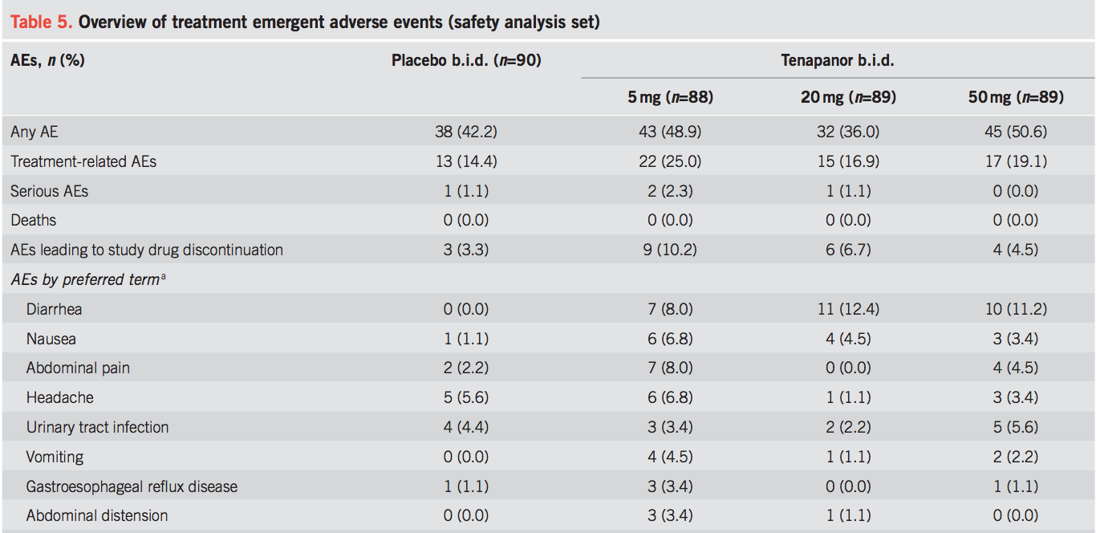

Slide 45
2 kiwi fruit per day more effective than 7.5 g psyllium in increasing CSBM
Notes:
Cystein protease actinidin
The MRI data suggest that consumption of kiwifruit in healthy participants increases water retention in the small bowel and ascending colon, as well as increasing colonic bulk.

Slide 46
Cinca et al. APT 2013
(n=240 females with CC)
Superiority of PEG above prucalopride demonstrated even when this was designed to be a non-inferiority trial

Slide 48
Nelson et al. Gut 2017 Systematic review and MA
Current drugs for CIC show similar efficacy. Bisacodyl may be superior to prescription medications for Δ_{b} in the number of SBM/week in CIC.
Notes:
How does linaclotide compare to other drugs?

Slide 49
Linaclotide in IBS-C
Chey et al. AJG 2012

Slide 50
Linaclotide in IBS-C
Rao et al. AJG 2012

Slide 51
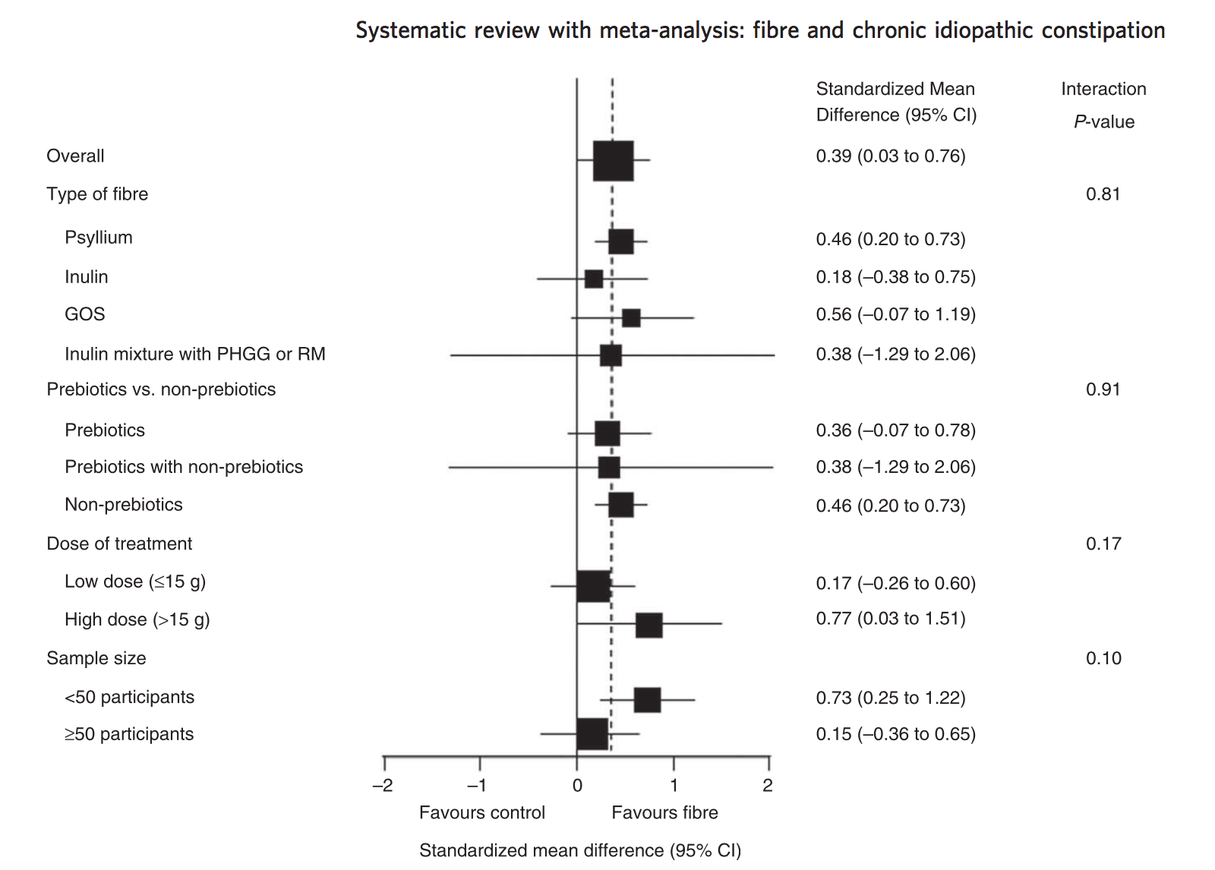
Christodoulides APT 2016
Notes:
Christodoulides APT 2016

Slide 52
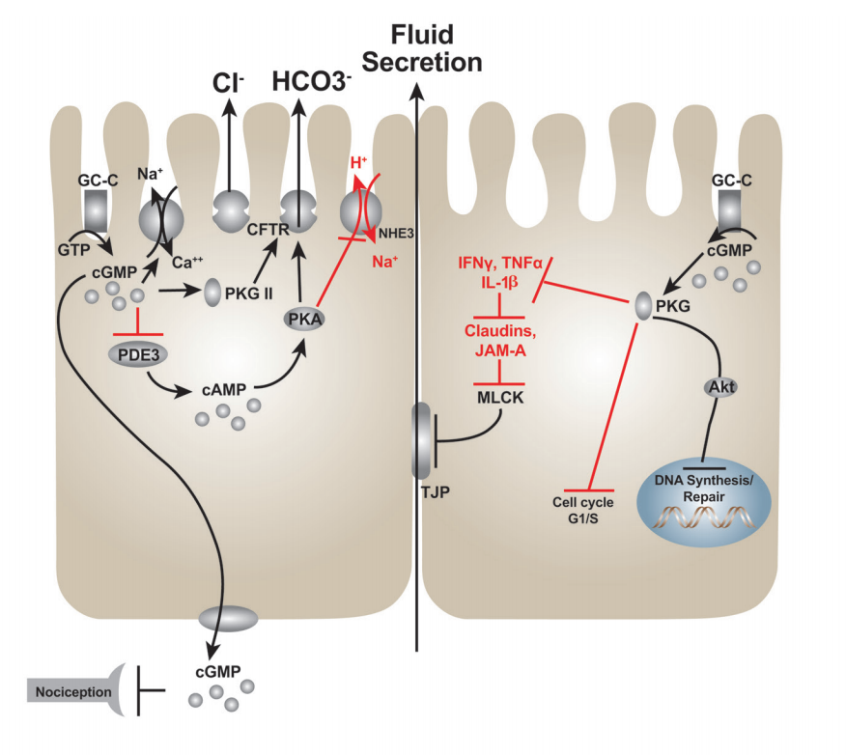
Walden and Camilleri Gut 2018

Slide 53
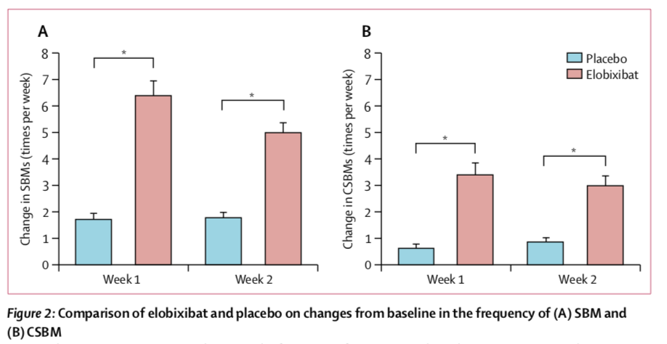
Elobixibat: inhibitor of ileal bile acid transporter (ph3)
Nakijama et al. Lancet Gastroenterol 2018

Slide 54
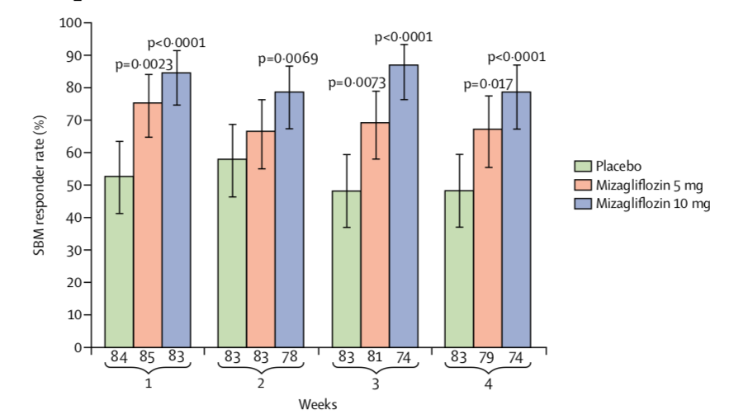
Mizagliflozin: sodium-glucose cotransporter 1 inhibitor (phase 2 trial)
Fukudo et al. Lancet Gastroenterol 2018

Slide 55
No.2-TRIAL: Sacrale neuromodulatie versus conservatieve behandeling bij slow-transit obstipatie
Sacrale neuromodulatie
Minimaal invasief
Stimulatie van S3 zenuw
Conflicterende resultaten bij (slow-transit) obstipatie
Studies van suboptimale kwaliteit
Variërende studieopzet
Geen kosteneffectiviteits-studies

Slide 56
Studie opzet
Design: Multicenter RCT
Doel: (Kosten)effectiviteit van sacrale neuromodulatie versus conservatieve behandeling in patiënten met refractaire idiopathische slow-transit obstipatie
Populatie: Patiënten (14-80 jaar) met idiopathische slow-transit obstipatie, ongevoelig voor conservatieve behandeling
Totaal: 64 patiënten (38 sacrale neuromodulatie, 26 controle)

Slide 57
Verwijs informatie
Maastricht UMC+
Zuid / Oost Nederland
Dr. SO Breukink
E: s.breukink@mumc.nl
Studiecoördinator:
Drs. SCM Heemskerk: stella.heemskerk@mumc.nl
Groene Hart Ziekenhuis (Gouda)
Noord / West Nederland
Dr. CIM Baeten
E: coen.baeten@ghz.nl

Slide 58
Pharmacological targets in chronic constipation
1. Increasing bowel motility
2. Increasing water content in bowel
- Increasing secretion into the intestinal lumen (secretagogues)
- Inhibition of solute absorption
Notes:
One of the primary instruments in the medical management of constipation is pharmacotherapy. As far as pharmacological targets are concerned
Some agents can act by both inducing motility and secretory responses

